Slide 1
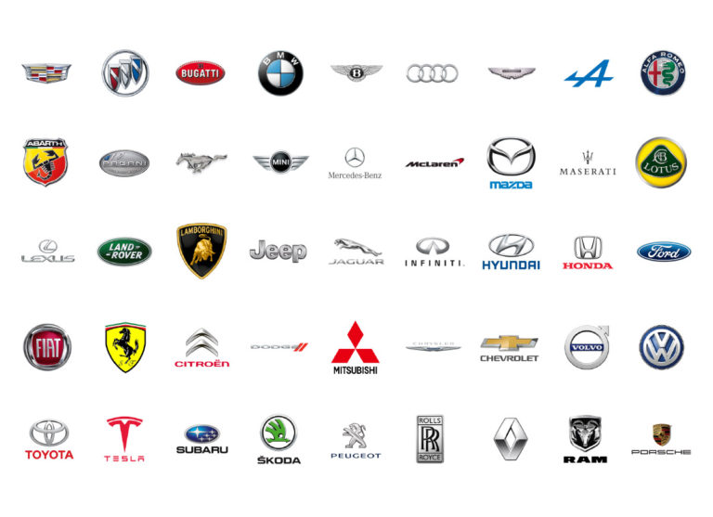

Systematic Car Classification System
By Hamza Yousaf

Slide 2
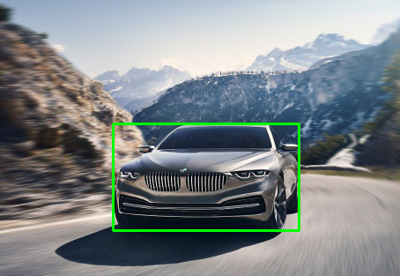
Problem Definition
In today’s day and age our lives have become heavily dependent on cars. There are billions of cars on the road today, serving the main and primary purpose of transporting people from one location to another. It is then necessary that we know the type of cars that we see and drive every day.
When criminal activity occurs, security cameras often capture a suspect vehicle. Being able to quickly detect and identify vehicle details can narrow down targets and allow law enforcement officials to act sooner.
For dealerships and private sellers in the car market, they can come across many cars for which they need to create listings for. It is expected that a car listing contains all the necessary information about the car.

Slide 3
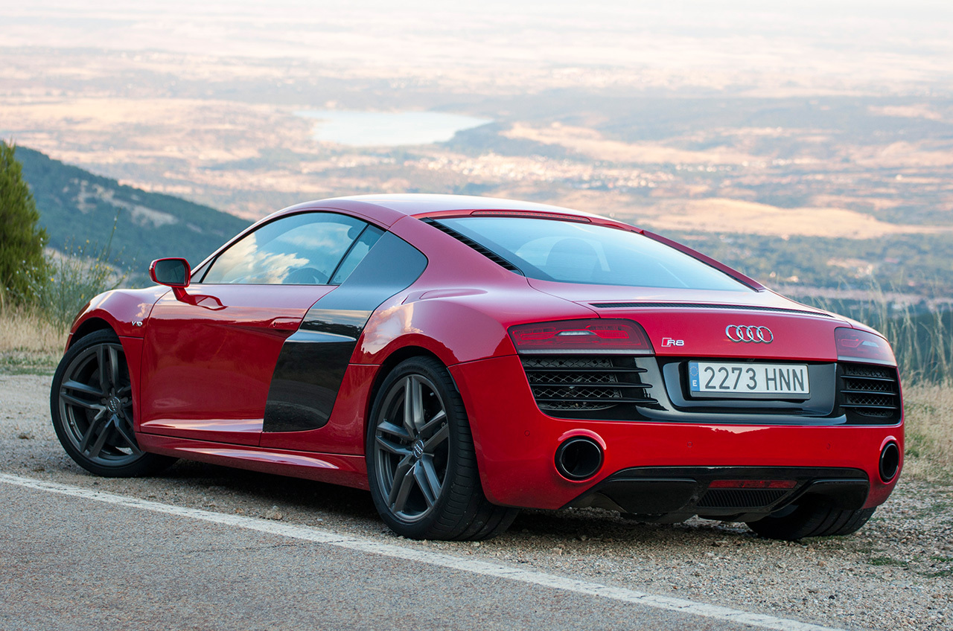
Goal
Our aim was to develop a car classification system where a user can input a picture of any car and then get all vehicle specifications about the car.
The classifier would also be able detect multiple cars within an image, highlight them using a bounding box, and then display information about each of the cars. Our primary objective was speed. We wanted users of the system to quickly retrieve the information they needed.
Audi R8 2014
CONFIDENCE: 93%

Slide 4
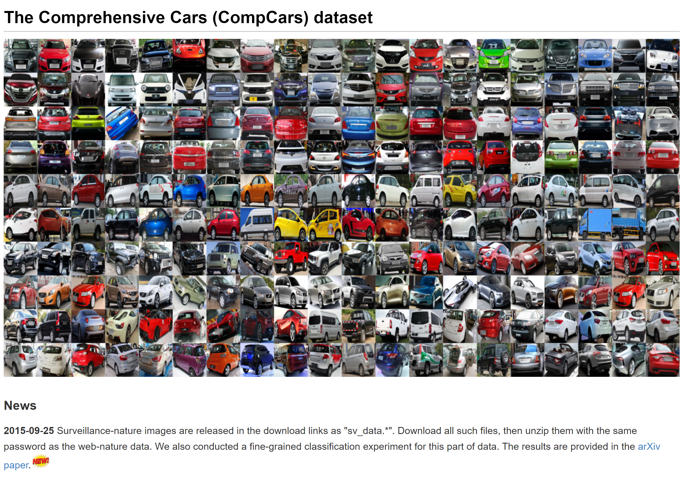
Dataset
We used the The Comprehensive Cars (CompCars) dataset which contains 163 car makes and 1,716 car models. There are a total of 136,726 images in the dataset.
The dataset contains cars models ranging from the years 2009-2015. We found this dataset to be comprehensive enough for our needs.
Although, outside of the scope of this project, there would be a need for even more comprehensive dataset.

Slide 5
ARCHITECTURE
The Systematic Car Classification System (SCC) was developed to systematically determine the car make, model, and year. We took several existing architectures for individual tasks and combined their results to reach our goal.
Our architecture is split into three main modules: car detection & localization, car make recognition, and model + year recognition with SIFT authentication. We shall describe the three modules separately, as each of them utilize their own architectures.
Car Object Detection
(YOLOv3)
BMW Model Recognition
(MobileNetV2)
Benz Model Recognition
(MobileNetV2)
SIFT
AUTHENTICATION
Car Make Recognition
(MobileNetV2)
Audi Model Recognition
(MobileNetV2)

Slide 6
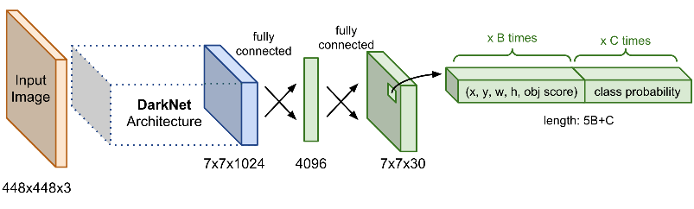
ARCHITECTURE – Car Detection & Localization
We used the classic YOLOv3 architecture (see Figure 1) for detecting the cars in the image.
Due to the complexity of the model and the scope of the project, it was not ideal to train the model. Instead, we used an existing pre-trained model from creators themselves.
The model was made to detect bounding boxes only around cars. We used the bounding boxes to get only the car images and packaged as input to the second component.
YOLOv3 Architecture

Slide 7
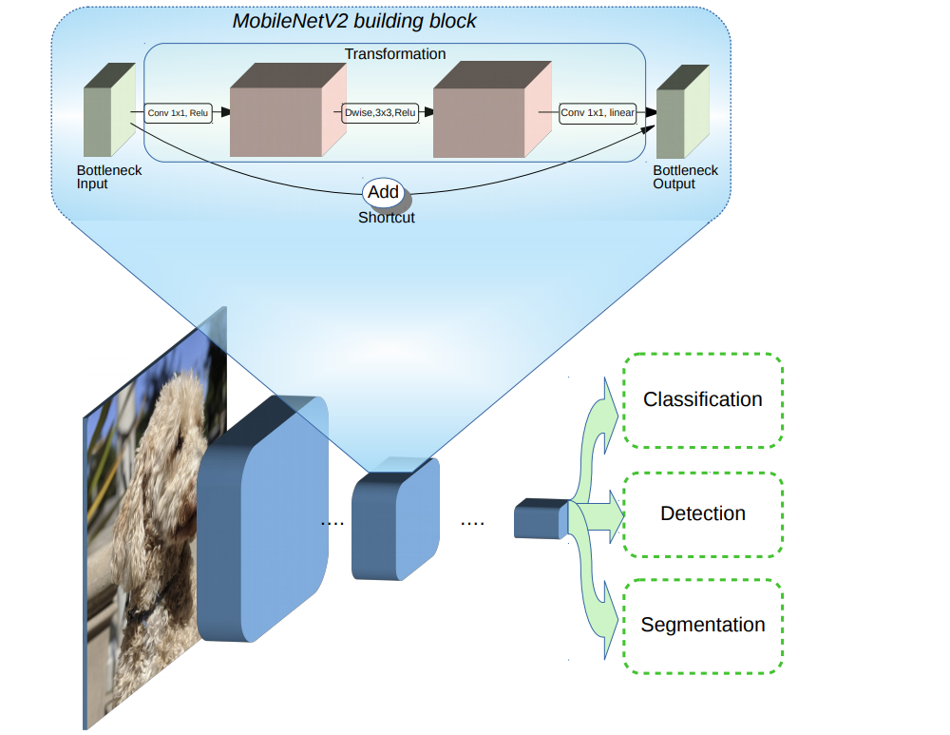
ARCHITECTURE – Car Make Recognition
We used the MobileNetV2 architecture (see Figure 2 and Figure 3) with pre-trained weights to detect all possible makes of cars (due to the scope of the project, we detect only 15 common car makes).
The architecture used was the same as described in the original paper, except we added several dense layers and a softmax layer that would output to 15 different classes.
MobileNetV2 Architecture

Slide 8
ARCHITECTURE – Car Model + Year Recognition
Once the make of the car is known, the final step is to feed the car through a neural network model tailored for the specific make.
We created 15 models, each of which are based on the MobileNetV2 architecture. Each model was trained using the images of cars of the corresponding make.
Each model, then with some confidence, predicts which model + year the car is.
BMW Model Recognition
(MobileNetV2)
M1
Benz Model Recognition
(MobileNetV2)
M2
.
.
.
Audi Model Recognition
(MobileNetV2)
M15

Slide 9
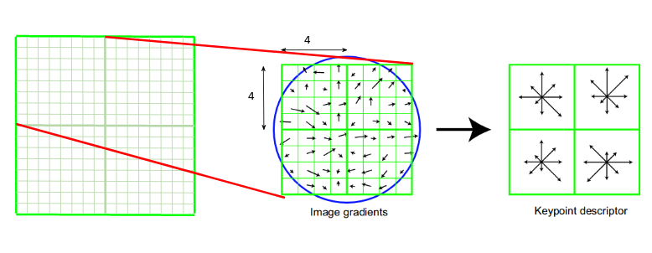
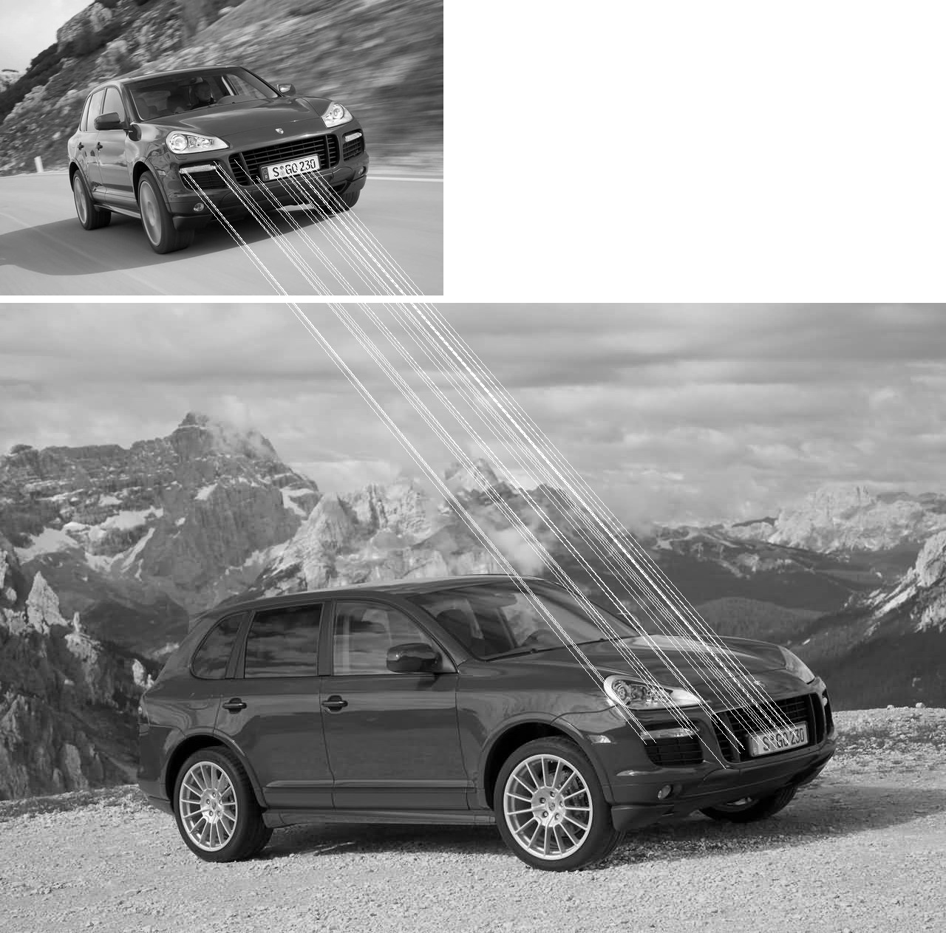
ARCHITECTURE – SIFT Authentication
We decided to add an extra layer of authentication and use SIFT to also figure out the make of the car.
Our model outputs softmax scores for the prediction of the car model + year. Starting with the top-most score, we retrieve an image from our dataset that reflects the class of the score.
The image retrieved will ideally have the same pose as the detected car.
We first detect and compute the matching keypoints and descriptors. We then use Lowe’s ratio test to keep the best matches.
Finally, we compute the accuracy by dividing the total # of good keypoints by the total number of keypoints.
This is done across all images to get one final confidence accuracy.

Slide 10
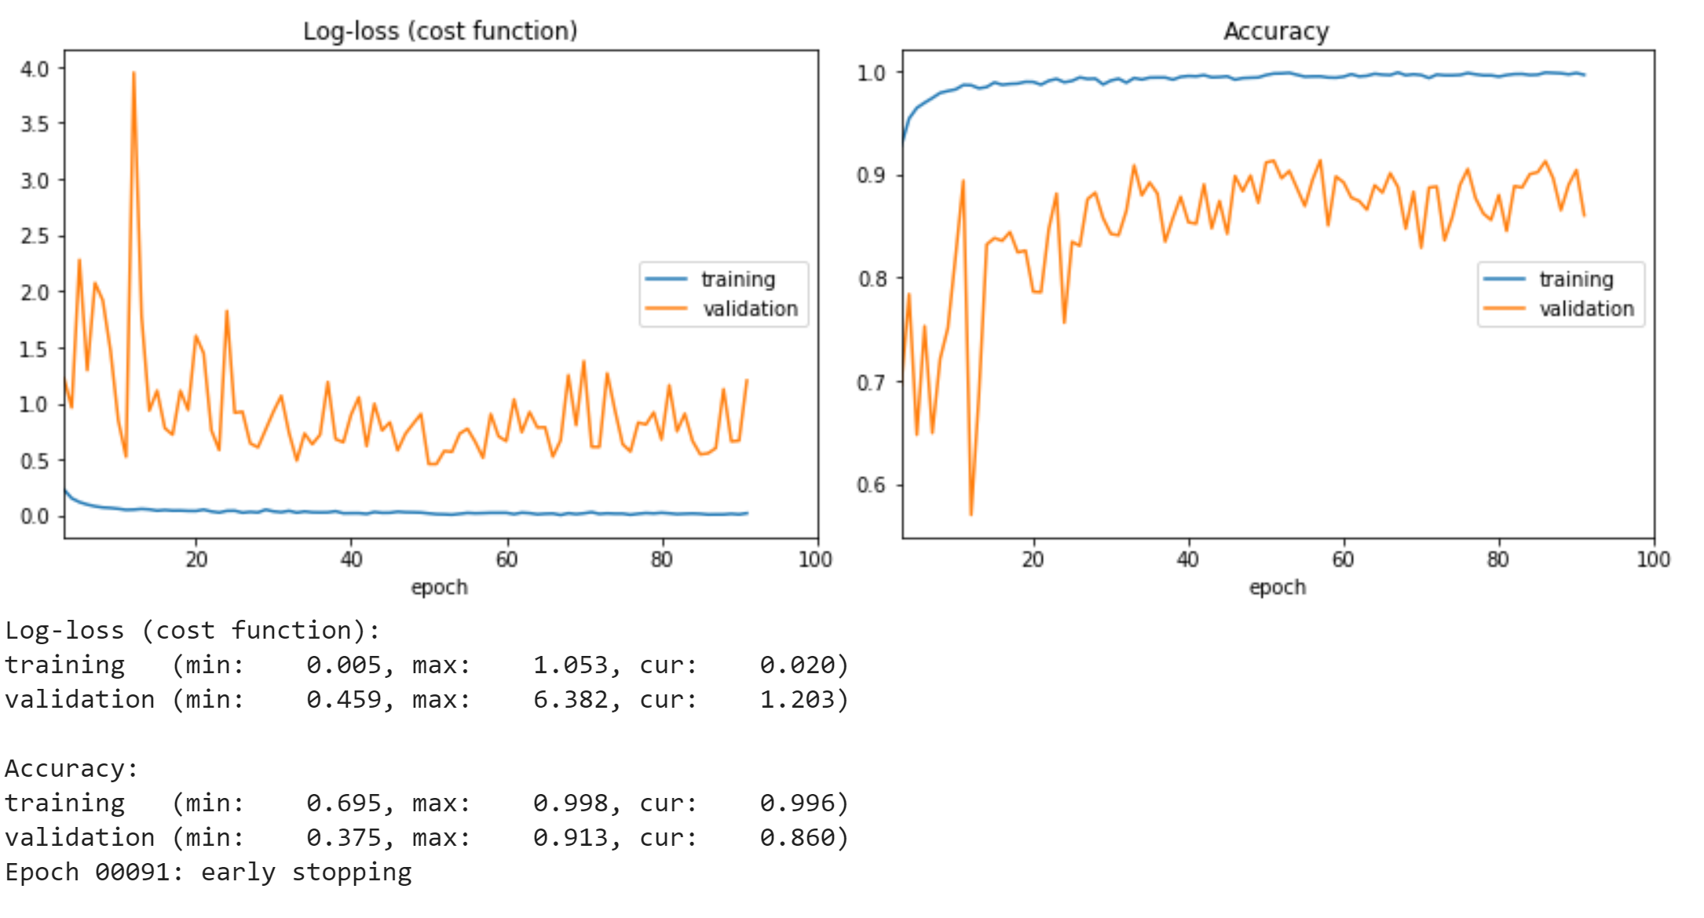
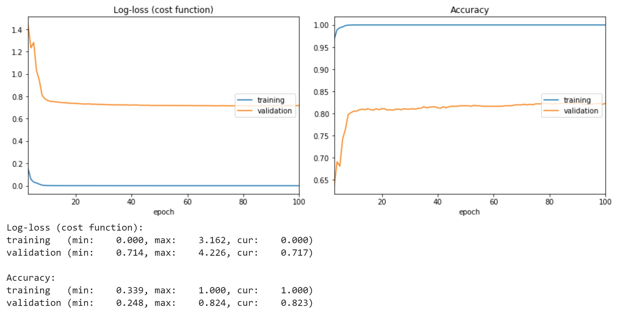
Results - Training
Car Make Model Training
BMW Model Training

Slide 11
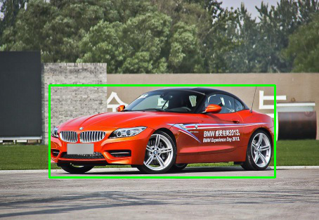
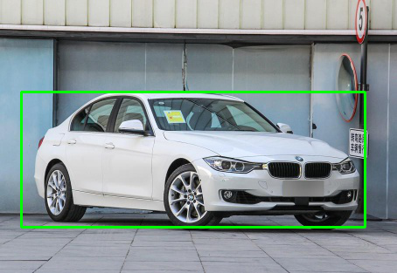
Results – Car Detection – YOLOV3
Bounding boxes detected by the pre-trained YOLOv3 model. The boxes presented are for visual purposes only, the actual function returns the images cropped to these boxes

Slide 12
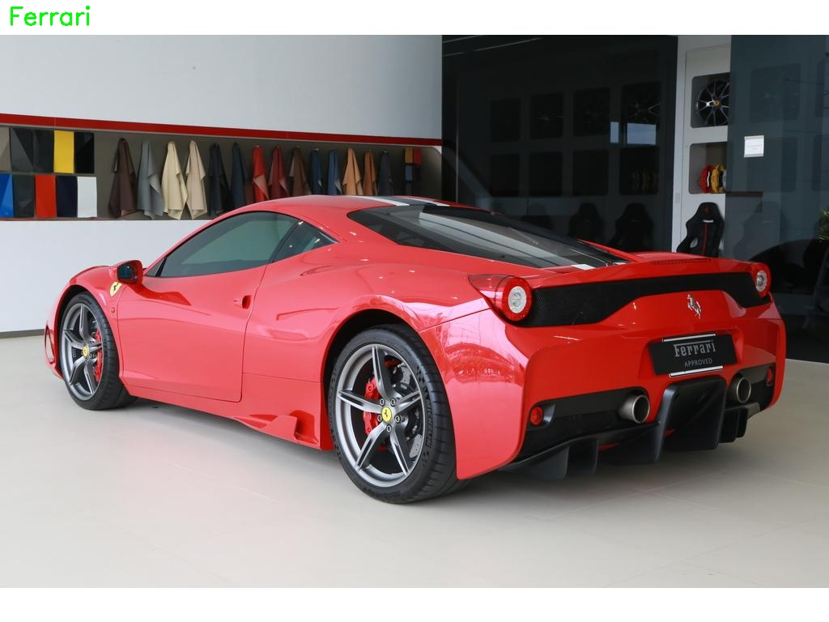
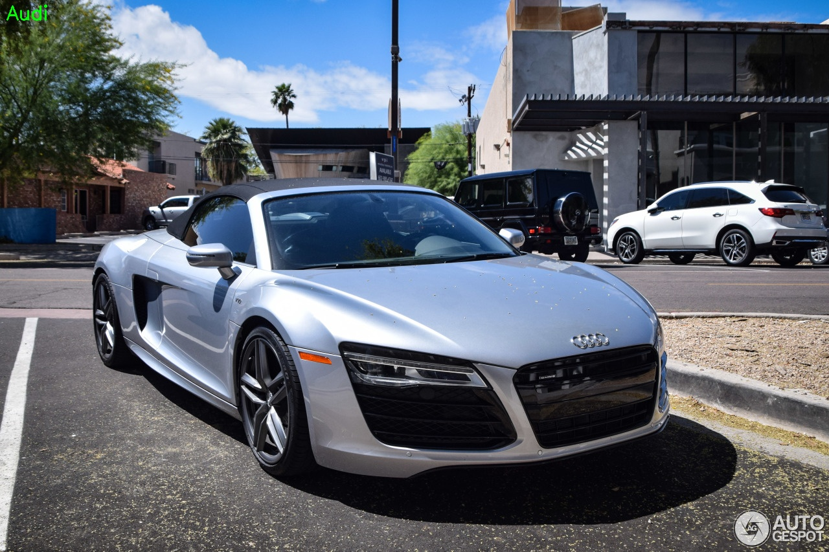
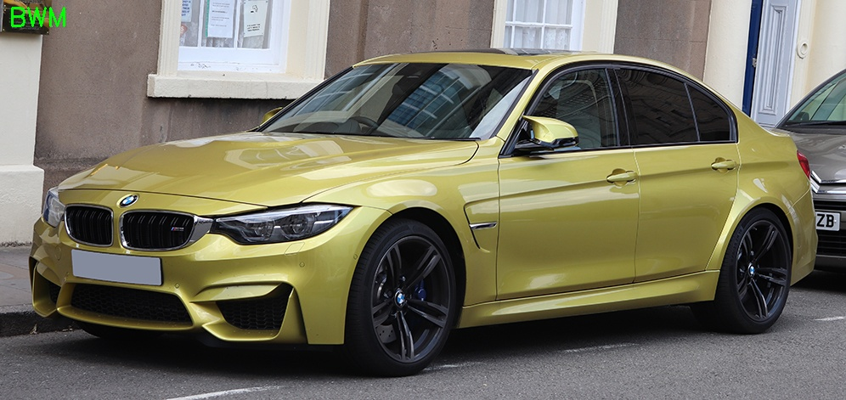

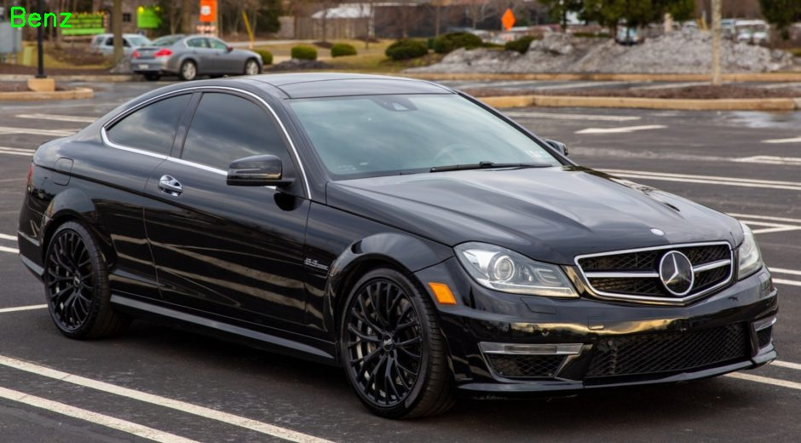
Results – Car Make Recognition – ModelNetV2
Predictions made by the Car Make Model. The car make prediction is reported on the top left. This output is only presented for visual purposes, the actual output is just the car make string.

Slide 13
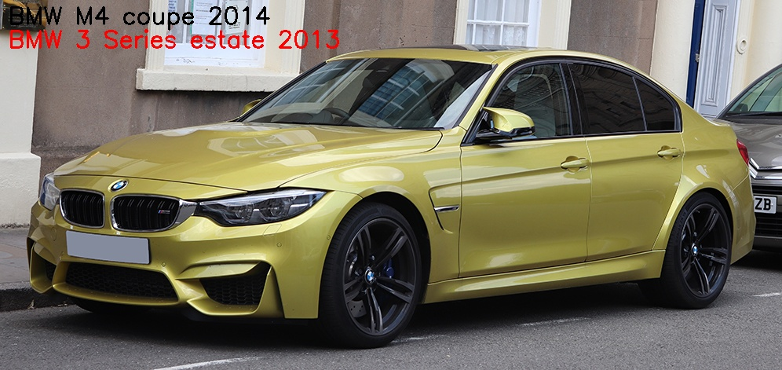
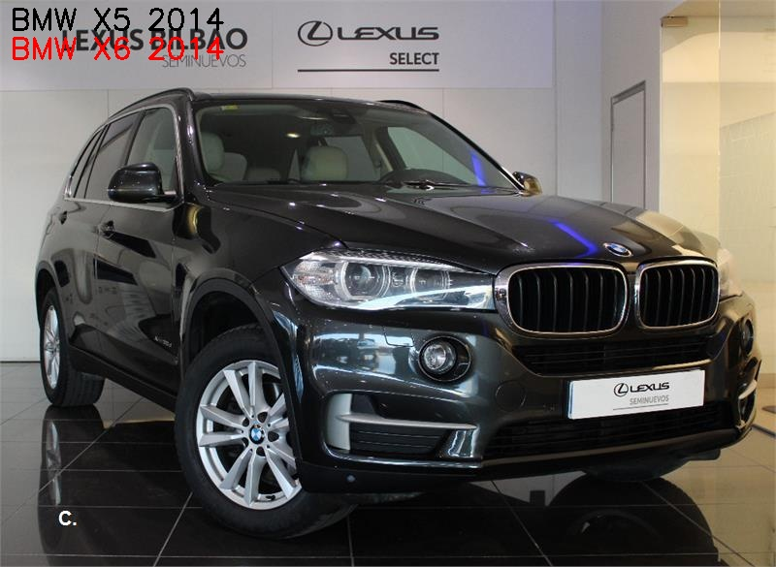
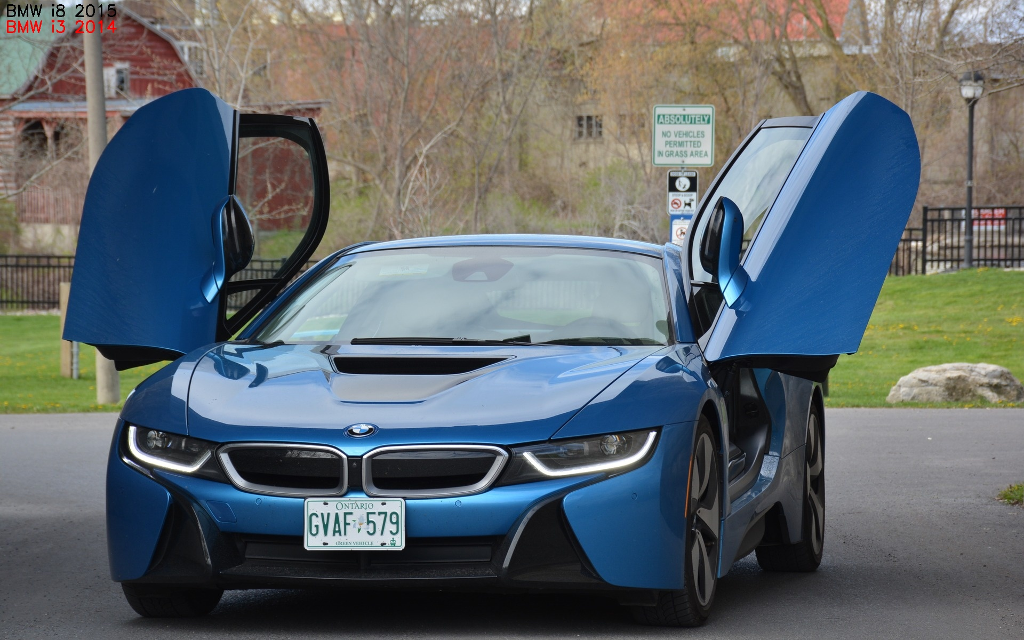
Results – Car Model Recognition – ModelNetV2
All the predictions made were incorrect to a certain degree. We did expect incorrect predictions due to a low validation accuracy.
But, if one observes the differences between the actual car models and the predicted car models, it isn’t surprising that our model was wrong.
Some of the car model predictions were correct but with the wrong year, and other predictions had different models but the differences in the models were too minor.
If we had trained our BMW model accurately, then we are sure the class predictions would have been a lot more closer to the actual classes.

Slide 14
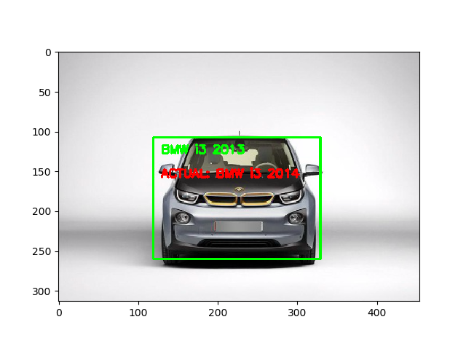
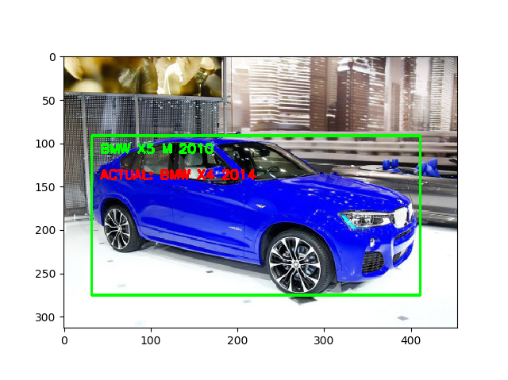
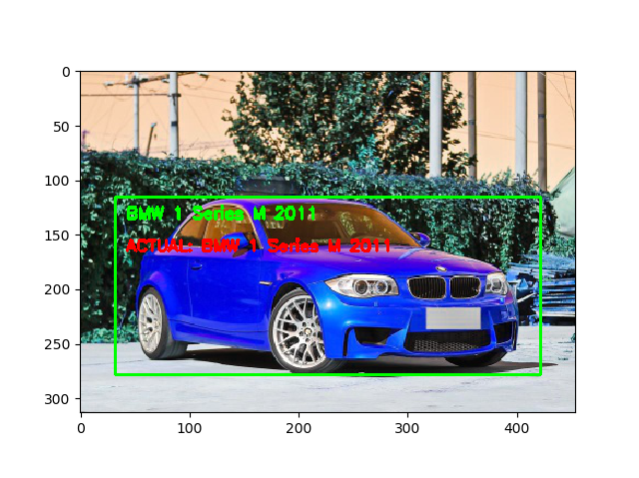
Results – Final Results

Slide 15
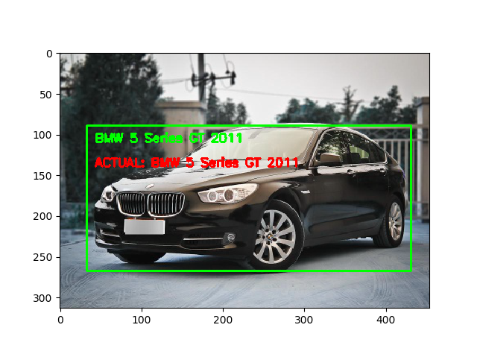
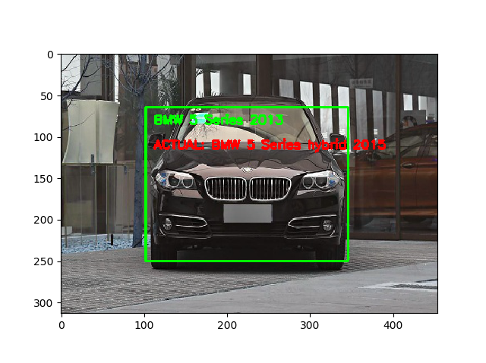
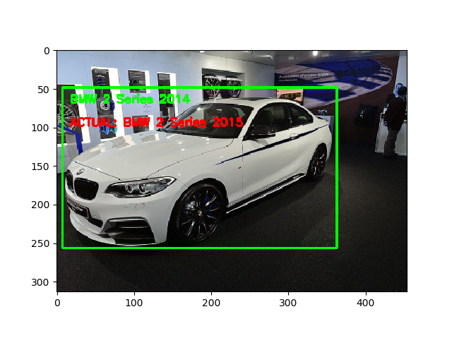
Results – Final Results

Slide 16

Main Challenges – Time Constraints
The dataset we used had to be limited to only a couple car makes (15). It is quite time consuming to train a model on hundreds of thousands of images. We lacked the proper hardware to do it in an efficient manner. So, we had to work with 1/4th the size of the dataset to train our Car Make model.
Time also constrained the number of Car Model models we could train. We were only able to train 3 models (BMW, Benz, Audi) for recognition. These models did not have enough time to train as they achieved only 80% validation accuracies. Given more time to play around with parameters, an ideal validation accuracy for the models would have been 95%+.

Slide 17
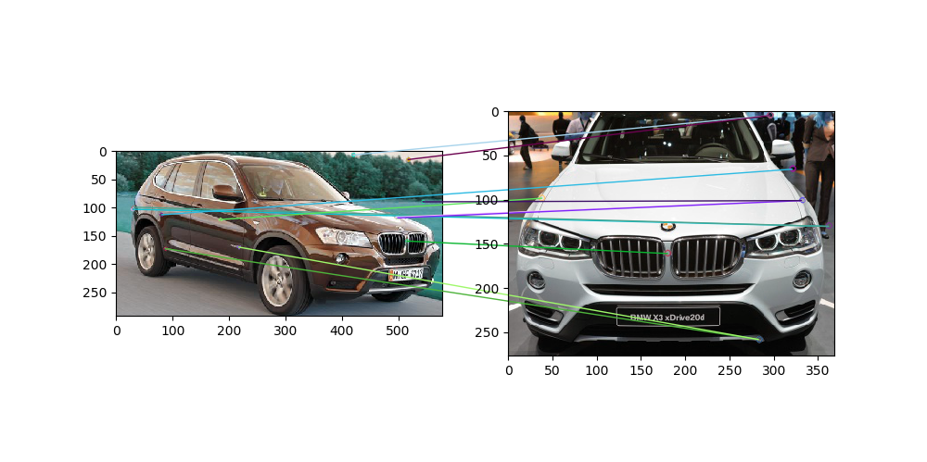
Main Challenges – SIFT Authentication
We were unable to fully develop out SIFT Authenticator algorithm. With the current implementation, given an image of a car and its class, the algorithm would retrieve a random image from that class and compute the accuracy of the prediction. It would have been better instead to choose an image which had the same post as the input image, therefore making the accuracy prediction of the algorithm more authentic. We were also unable to fully implement the calculation of the homography that would map one image to the other.

Slide 18
Topics Covered
Convolutional Neural Networks (YOLOv3, ModelNetV2)
Used for detections and recognition
SIFT (OpenCV)
Used to authenticate the recognitions made by our models

Slide 19

Future Works
We plan on first overcoming the challenges discussed in the previous section by allocating more time to the training process.
We will like to experiment with different models for detecting makes and models.
The SIFT authentication can be improved by automatically finding a similar pose to the image being authenticated.
We want to create an easy to use API to allow developers to access and deploy our system onto their own applications.

